Slide 1
subject
Front view
Side view
Bottom view
(better looking then top since there’s a large hole at the top of a T1)

Slide 2



HAP

Slide 3



LB

Slide 4



MB

Slide 5



MJD

Slide 6

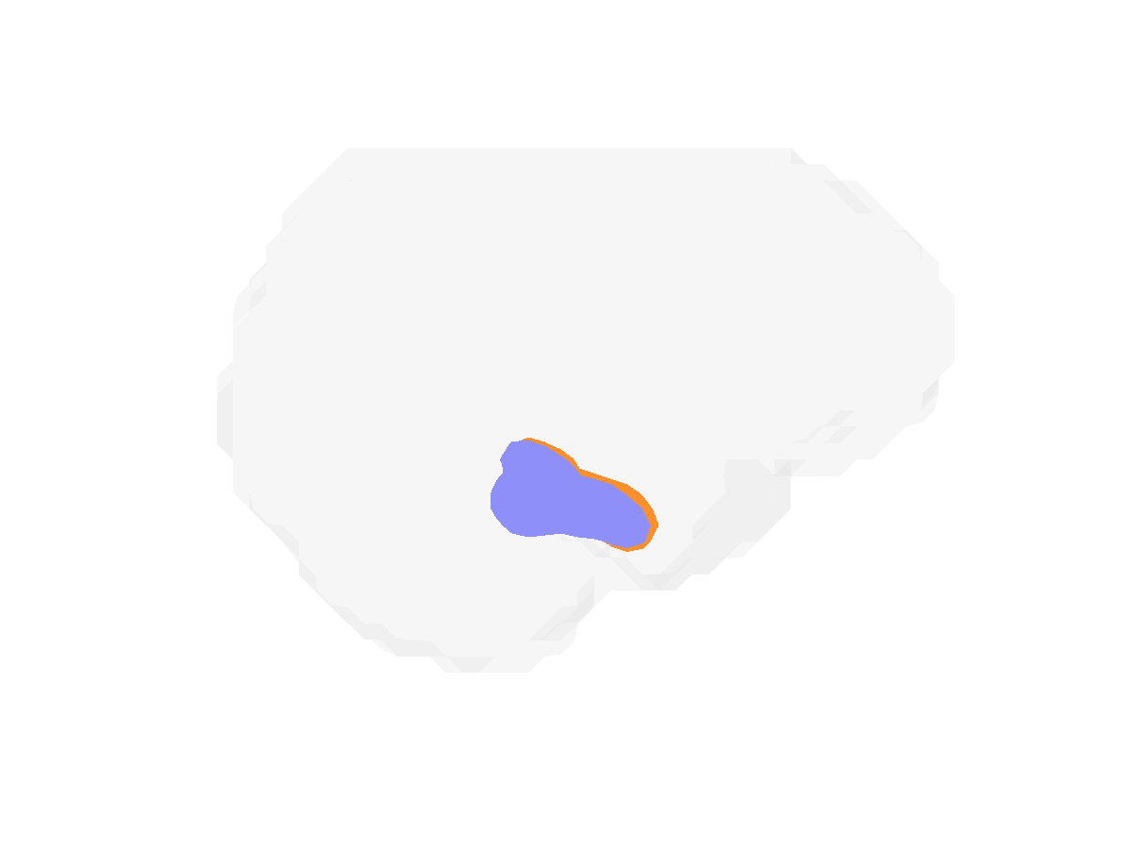

NSP

Slide 7



RTS

Slide 8



TSL

